Slide 1



Knowledge Sharing and Team Working
Course Introduction
Svetlin Nakov
Manager Technical Training
www.nakov.com
Telerik Software Academy
academy.telerik.com

Slide 2



Table of Contents
Course Objectives & Program
Team Work Projects
Assessment
Learning Resources

Slide 3



Course Objectives & Program
What Topics Shall We Cover?

Slide 4

Open Knowledge and Education
What is "open knowledge sharing"?
A modern concept in education and society
Knowledge becomes open to the world
High-quality training becomes free
Idea broadly supported by:
World's top universities like Harvard, MIT, Berkeley, Stanford, Oxford, Cambridge, …
Online free training sites:
Khan Academy, Coursera, Udacity, edX, Ucha.se, Codecademy, Code School, Telerik Academy, …

Slide 5

The Course Objectives
Knowledge Sharing and Team Working goals
Develop a culture of open sharing of knowledge
Learn to enjoy helping others
Learn to work in a team
Real-world practical projects
Teams of 3-7 people
Help the software academy to grow and operate its free trainings
Promote the free trainings at the academy
Assist the training team in teaching the courses

Slide 6
Course Benefits for the Students
Benefits from the course for the students
Adopt the open knowledge sharing culture
Build their own blog
Your blog is more than online CV!
Build their own public developer profile (at GitHub / Google Code / CodePlex)
Get team working experience
On real-world projects
Learn how to learn: mind mapping, speed reading and efficient learning

Slide 7
Course Benefits for the Academy
Benefits from the course for the Academy
Trainers teams will get some help
Volunteer assistants for the courses
Support for the training activities
Additional courses / guest lectures
Marketing benefits
More popularity due to blogging
More people will learn about the Academy
Great people will be shortlisted for employment

Slide 8
Course Program
Part I – Knowledge Sharing and Efficient Learning
Course Intro & Open Knowledge Sharing Culture
Software Engineering Motivational Essay
Starting Your Own Blog: How to Share Knowledge and Help Others?
Source Control Systems for Project and Team Collaboration: SVN, TFS and Git
Mind Mapping: Efficient Notes and Creativity
Efficient Learning: Speed Reading and Memory Techniques (by Tony Buzan)

Slide 9

Course Program (2)
Part II – Team Working
Presenting the Team Work Projects
Application Process
Teams Work on Their Individual Projects
Internal Meetings
Project Activities
Prepare for Public Defense
Public Defense (periodically)
Public Presentation

Slide 10
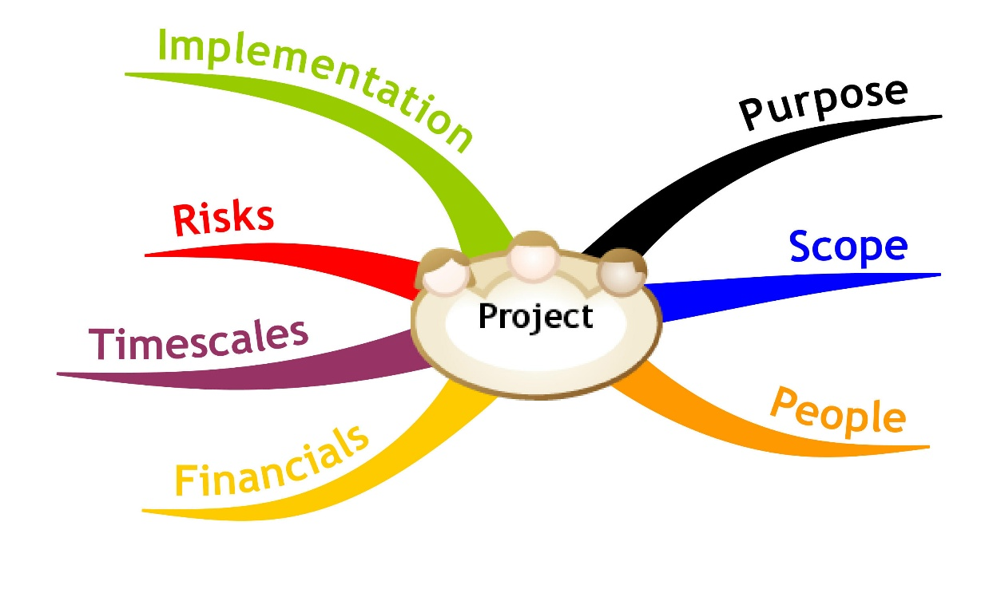
Team Work Projects
Application Process, Team Work Process, Examples

Slide 11
Team Work Projects: The Application Process
The application process for the team projects:
The projects descriptions are listed in Internet
Projects are publicly presented
Students apply for few of the projects
Motivated applications with cover letter
Ordered list of 3-5 preferences
Students are approved based on
Demonstrated relevant skills and experience
The exam results an the academy

Slide 12
The Team Work Process
The team work process:
The members of each project decide on:
Collaboration tools (like Google Docs, Skype, Facebook group, Email group, …)
Source control repository (SVN / Git / TFS)
Organizational and PM process
Tasks distribution, resources, deadlines, etc.
Working space (at home / at the academy)
Meetings (on-site / online)
Reporting and presentation process

Slide 13
Sample Projects
Each team work project has:
Name, goals, description, requirements for the team members, project owner
Examples:
Training Assistance Team
Assistants for the courses in the academy (e.g. C#, CSS, Photoshop)
Digital Marketing Team
Daily blog of the academy

Slide 14
Sample Projects (2)
More Examples:
Sports Team
Organize sport activities in the academy
YouTube Team
Organize the academy videos
Forum Moderators Team
Moderate the forum
Feedback Team
Collects feedback from the courses, trainers, etc.

Slide 15
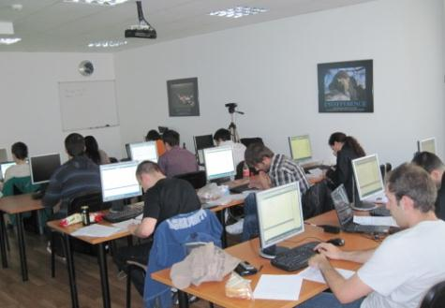
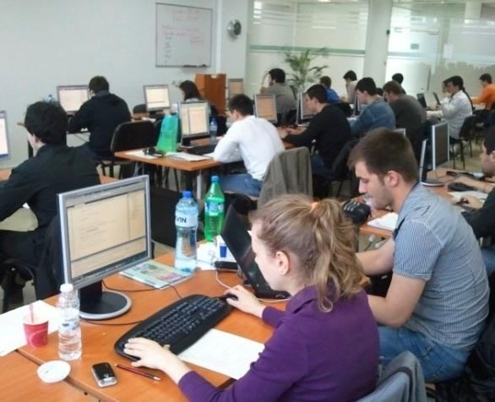
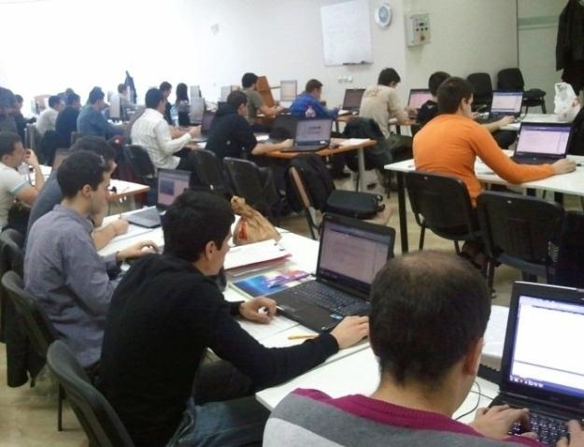
Assessment
Assessment Criteria

Slide 16

Assessment
Part I – Knowledge Sharing
Essay – 20%
Blog – 30%
Source Control Systems – 20%
Mind Mapping & Efficient Learning – 30%
Part II – Team Working
Team Score – 70%
Individual Score – 30%
Evaluated at several passes

Slide 17

Pass-Fail Criteria
To "pass"
At least 30% of score for Part I
Essay% + Blog% + Source Control Systems% + Efficient Learning% >= 30%
Same for Part II
To "pass with excellence"
At least 70% of score for each Part
Note: passing is obligatory if you intend to work in Telerik

Slide 18








Resources
What We Need in Addition to This Course Content?

Slide 19
Course Web Site & Forums
Register for the "Telerik Academy Forums":
Discuss the course exercises with your colleagues
Find solutions and assistance for the exercises
Share source work / discuss ideas
The course official web site:
http://forums.academy.telerik.com/knowledge-sharing-and-team-working
academy.telerik.com/student-courses/soft-skills-and-business-skills/teamwork/

Slide 20


Books
Buzan Study Skills Handbook: The Shortcut to Success in Your Studies with Mind Mapping, Speed Reading and Winning Memory Techniques
by Tony Buzan, Pearson Education, 2007 ISBN 978-1-4066-1207-3
Как да уча бързо и да запомням лесно
Тони Бюзан, Софтпрес, 2011 ISBN 978-954-685-837-5

Slide 21
Knowledge Sharing and Team Working
http://academy.telerik.com

